Slide 1

AI PRACTITIONER TEAM 1 IBM IMVAI-2001

Slide 2
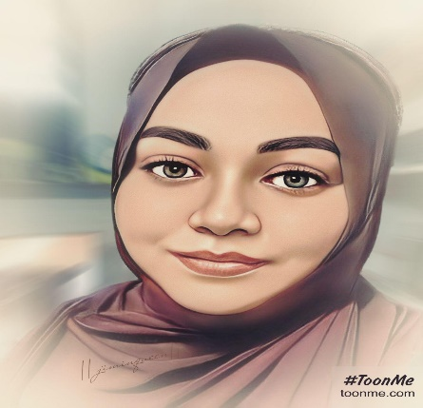

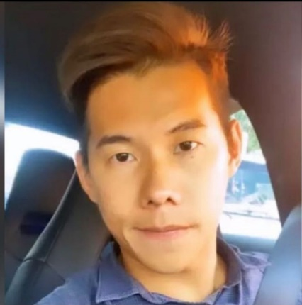
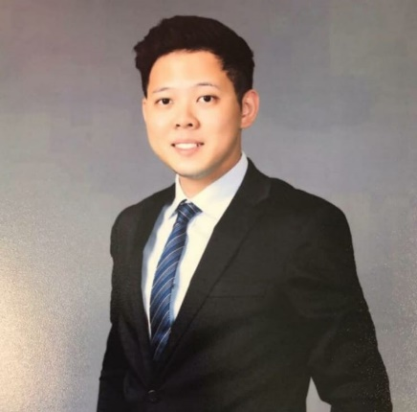

MEET the TEAM
Responsible for making the magic happen…
Anisah Binte Sudarman
Known to be passionate and strong willed. Forge on despite the odds.
Jamie Bin
Known to be intuitive and driven in making things work.
Norman Tay
Known to be an active listener, and formulate optimal solutions.
Branden Chan
Known to be quiet with deep thinking skills.
Jeremy Lim
Known to share the best deals and lobangs.

Slide 3

Presentation Flow
Inception
Project Planning and Design
Venture Thesis
Enterprise Design Thinking
AI Design Essentials
Data
Understanding
Reasoning
Knowledge
MVP Demo
Project Learnings

Slide 4
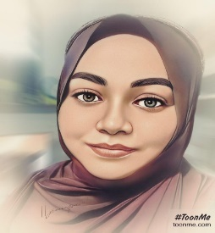
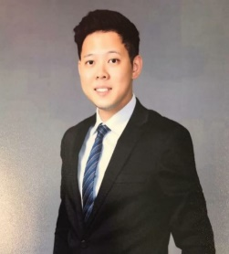


PRESENTATION FLOW
- Inception
- Project Planning & Design
Slides 1-12
- Venture Thesis
- EDT
Slides 13-21
- MVP Demo
Slides 43-51
- Project Learnings
Slides 52-62
- Data
- Understanding
Slides 27-32
- Reasoning
- Knowledge
Slides 33-42
¬ AI Design Essentials
Slides 22-26

Slide 5

INCEPTION
Project Objective

Slide 6
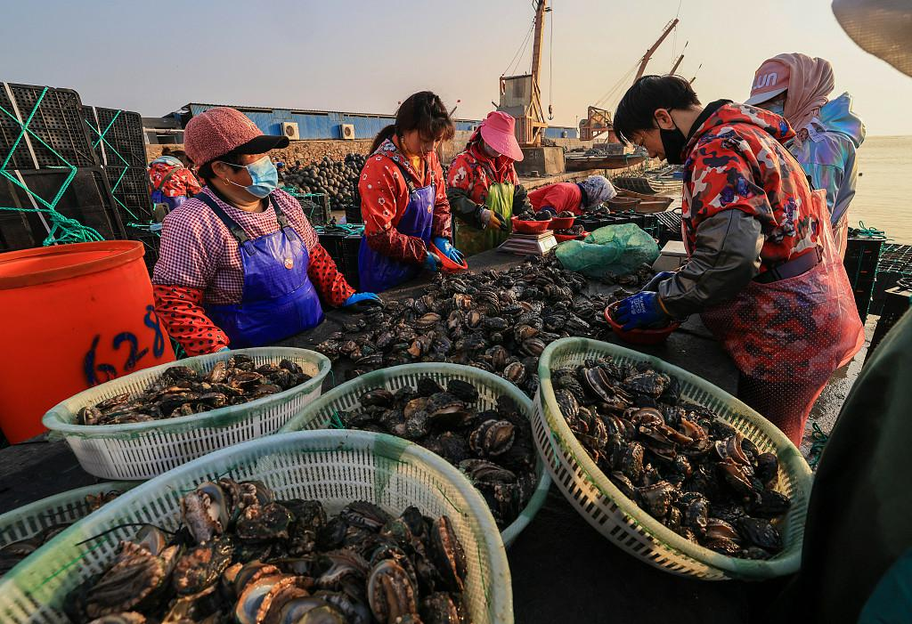
PROJECT OBJECTIVE
Illustrating an
AI SOLUTION
addressing the challenges that abalone farmers faces.

Slide 7
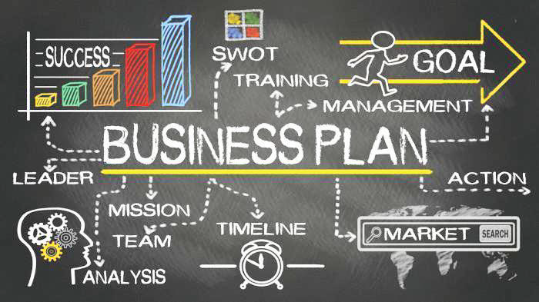
PROJECT PLANNING & DESIGN
Flow Planning Design
Technical Planning & Consideration
Team Member’s Task Allocation
Planning & Timeline

Slide 8








FLOW PLANNING DESIGN
Discussion and Discovery
Data Collection
Uniting the project development
Deploying finalized product
Working with Data

Slide 9
TECHNICAL PLANNING & CONSIDERATION
Advantages of Tools Used:
Kaggle
1. Easy Access
2. Convenient
GitHub
1. Free and sufficient storage for newbies
Heroku
1. Free and sufficient deployment for newbies
PowerPoint
1. Efficient slide making and compilation
Mural
1. Quick collaboration
Tools in IBM Cloud
1. Easy Navigation
2. Fast development

Slide 10
TEAM MEMBER’S TASK ALLOCATION
Names | Task Allocation
Anisah Binte Sudarman | 1. EDT Contribution 2. Machine Learning 3. Model Formation & Integration 4. Troubleshooting & Deployment 5. Chatbot Contribution 6. Individual slides contribution 7. Presentation Slides Collation and Finalization
Branden Chan | 1. EDT Contribution 2. PowerPoint Skeleton slides 3. Individual slides contribution
Jamie Bin | 1. Managing Initial Project Outline 2. EDT Contribution 3. Data Collection 4. Machine Learning 5. Chatbot Integration 6. Troubleshooting Chatbot 7. Individual slides contribution
Jeremy Lim | 1. Managing team’s discussions arrangement/ platform 2. EDT Contribution 3. EDT- Mural Collation and Finalization 4. Individual slides contribution 5. Machine Learning
Norman Tay | 1. EDT Contribution 2. Data Collection 3. Machine Learning 4. Individual slides contribution

Slide 11
PLANNING AND TIMELINE
Day | Date | Activity | Remarks
Friday | 1st July 2022 | Team Discussion | Worked together in Mural. Finalized topic to work on
Tuesday | 5th July 2022 | Team Discussion | Collected data. Worked with data in the different platforms
Wednesday | 6th July 2022 | Project Discussion with Suhaimi | Troubleshoot on the different platform issues. Access and worked in the different platforms.
Thursday | 7th July 2022 | Team Discussion | New topic chosen hence re-did the entire process before First deployment of model to website Chatbot draft created
Tuesday | 12th July 2022 | Team Discussion | Skeleton ppt created Troubleshoot deployment issues
Wednesday | 13th July 2022 | Team Discussion | Chatbot 2nd draft completed Webhooks integrated

Slide 12

PLANNING AND TIMELINE
Day | Date | Activity | Remarks
Thurday | 14st July 2022 | Midpoint Discussion with Suhaimi | Troubleshoot on the different platform issues. Coding and resolutions.
Friday | 15th July 2022 | Self preparation | Working on the different sections of the slides. Offline liaising among the team members.
Monday | 18th July 2022 | Self preparation | Collating the slides and rearranging the flow of the ppt. Offline liaising among the team members.
Tuesday | 19th July 2022 | Team Discussion | Final clean up of the presentation slides. Run through of the presentation slides.
Wednesday | 20th July 2022 | Self preparation | Individual run through of the presentation. Individual recording of the presentation. Final outlook of deployed model and chatbot in website
Thursday | 21st July 2022 | Final Project Presentation with Suhaimi | Present the Project with course mates and lecturer Project Submission

Slide 13
VENTURE THESIS
Project Topic
Business Opportunity

Slide 14
PREDICTING ABALONE’S AGE
A ONCE ENDAGERED SHELLFISH THAT’S SWEET RICH AND VERY EXPENSIVE.

Slide 15

BUSINESS OPPORTUNITY
Why is it important to predict the age of an abalone?
Abalone is considered a delicacy in Southeast Asia, and consumers are willing to pay a premium for high-quality abalone.
The rarity of this seafood and its laborious harvesting process makes it expensive. The economic value of abalone is positively correlated with their respective ages and other physical characteristics.

Slide 16
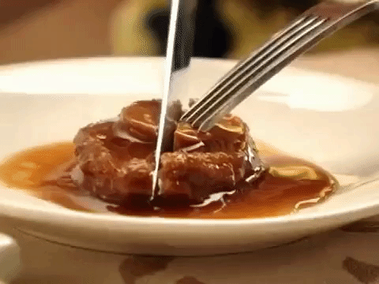
CONTINUATION →
This type of information helps farmers and distributors to determine the market price of abalones. By counting the number of layers in its shell, one can determine the age of an abalone.
It involves cutting a sample of the shell, staining it, and counting the number of rings through a microscope, which can be a tedious process.

Slide 17

ENTERPRISE DESIGN THINKING
How Might We Statement
Persona
Pain Points

Slide 18

HOW MIGHT WE STATEMENT
How Might We identify the age of abalone
For farmers So That they can be harvested for the best price in the market

Slide 19
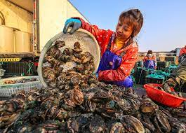
PERSONA
Name: Lynn Hong Age: 32
Location: Singapore
Education: Graduate
Job: Farmer
Work Experience: 6 Years
Family: Married Parent Technical Literacy: IT Savvy

Slide 20
PERSONA
Motivations: would like to harvest with (what to accomplish) the least amount of input
Goals: discover a tool that is able to (what motivates) give her the age results whenever she requires.
Needs: currently does not have a (unfulfilled today) way to calculate which abalones can be harvested .

Slide 21
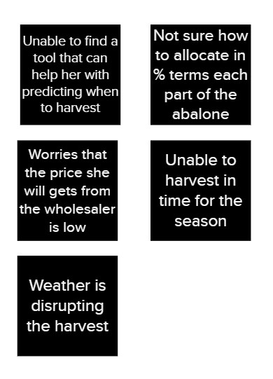
PAIN POINTS
Do any of these phases seem redundant or particularly difficult?
INEFFICIENCY (doing) FRUSTRATION (feeling) CONFUSION (thinking)
Top 2

Slide 22

AI DESIGN ESSENTIALS
AI Intent
Big Ideas
Ideas Prioritization Grid
Hills Statement

Slide 23
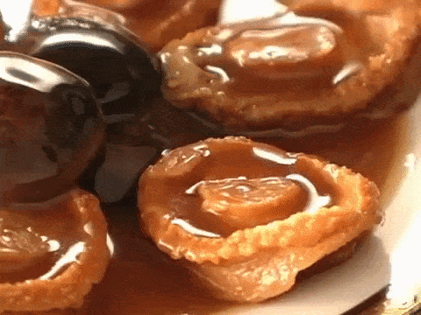
AI INTENT
Why are we doing this and how does it help?
By knowing the age, this will help prompt farmers on when to harvest so as to obtain the best market price.
By knowing when to harvest, farmers can make smarter decisions on when to start farming.

Slide 24
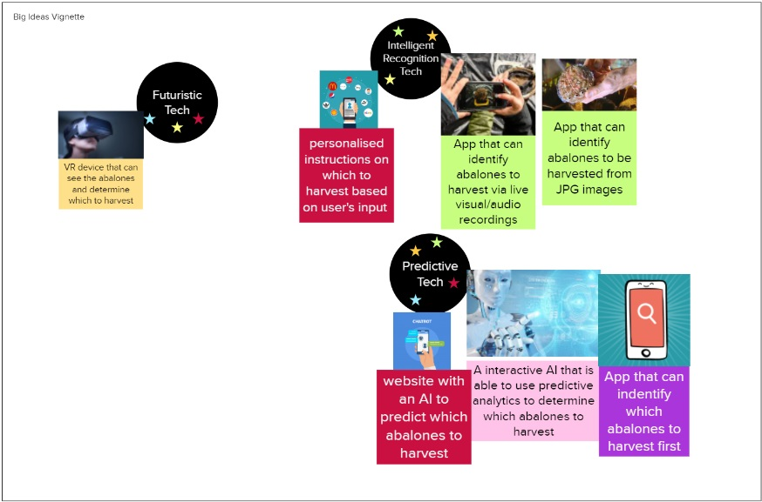
BIG IDEAS
WINNER

Slide 25
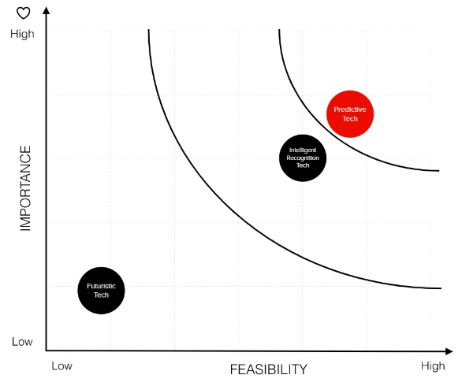
IDEAS PRIORITIZATION GRID

Slide 26
HILLS STATEMENT
WHO WHAT WOW
Farmers can harvest abalones based on their age saving them time from manually checking.

Slide 27
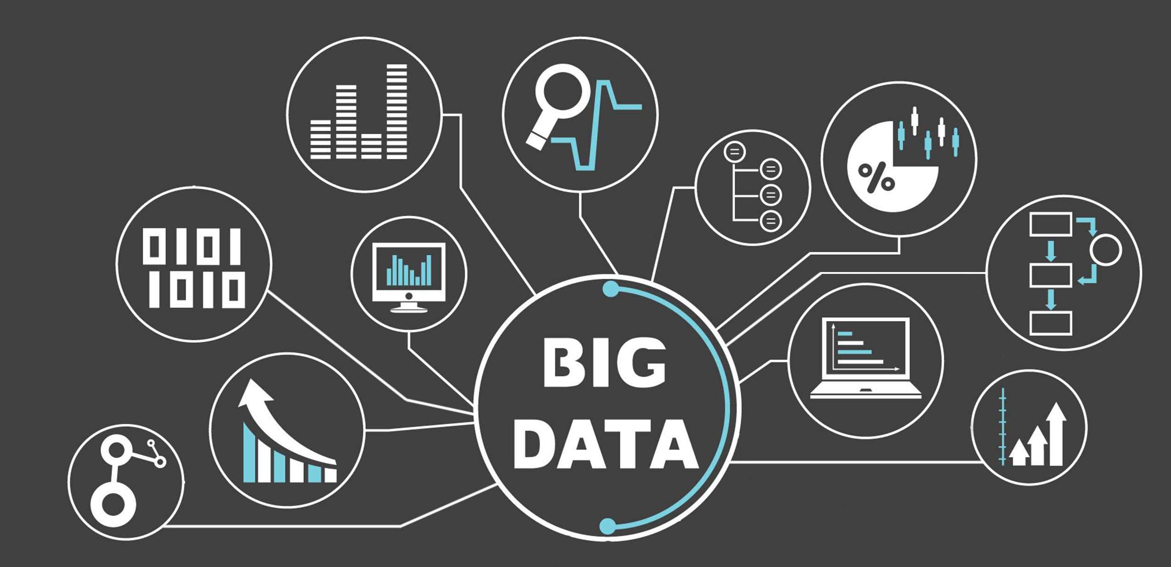
DATA
Data Collection

Slide 28
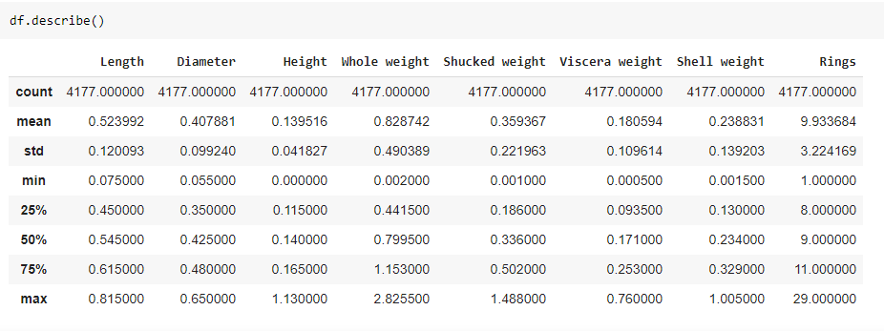
DATA COLLECTION
dataset = pd.read_csv('../input/abalone/abalone.csv')

Slide 29

UNDERSTANDING
Data Flow
Interpreting the Data
Data Refining

Slide 30
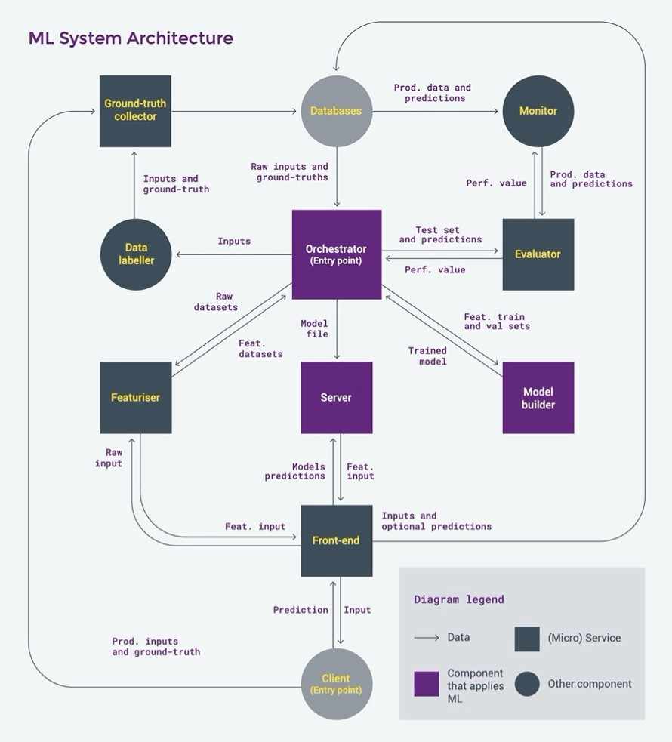
DATA FLOW
We have taken the following steps to train the model:
Know your data
2. Cleansing and analyzing of dataset
3. Choosing which model suits best for this dataset
4. Train the model using the algorithm chosen
5. Infer from the model
6. Making predictions using the model

Slide 31
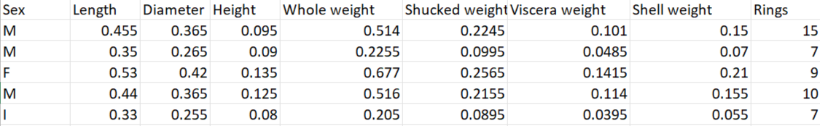
INTERPRETING THE DATA
First five rows of the dataset

Slide 32
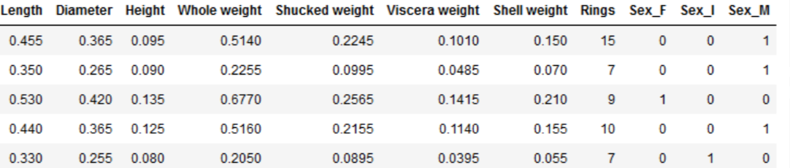
DATA REFINING
Data Cleansing:
Change of Sex Values from a CATEGORICAL to ORDINAL
Just an example; not the actual churned diagram.
2 | 3 | 1
2 | 3 | 1
2 | 3 | 1
2 | 3 | 1
2 | 3 | 1

Slide 33

REASONING
Feature Importance
Heat Map Correlation
Reasoning Statement

Slide 34
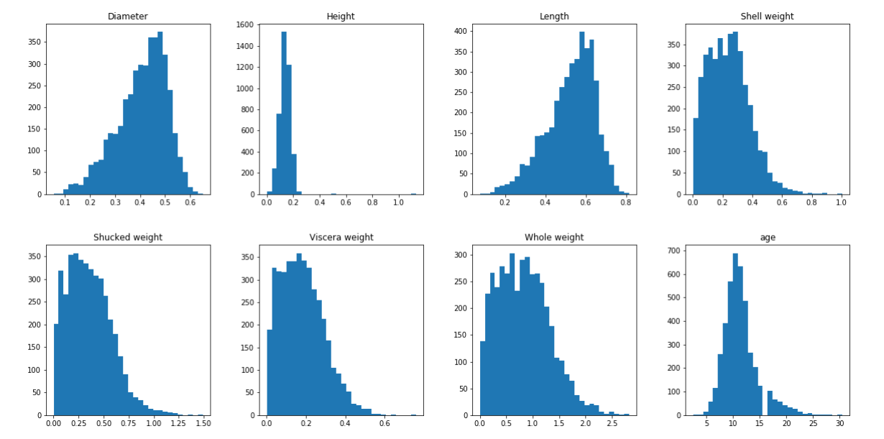
FEATURE IMPORTANCE

Slide 35
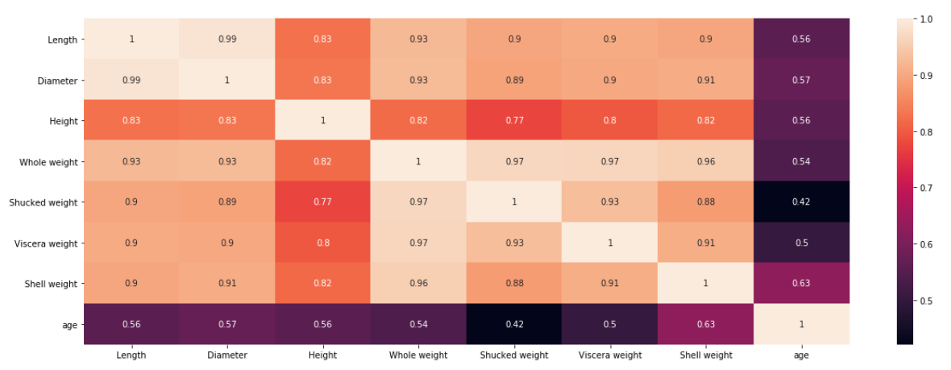
HEAT MAP CORRELATION
Inferences:
Features are highly correlated to each other
Shell weight is highly correlated with age of abalone
Age is least correlated with shucked weight of abalone

Slide 36
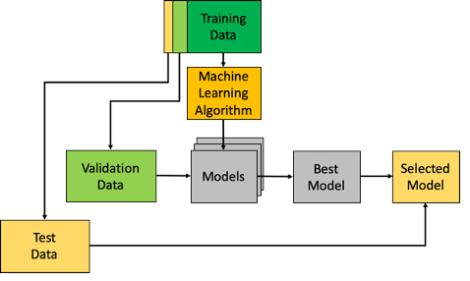
REASONING STATEMENT
We have tried to cover the prediction pipeline from data evaluation, data visualization, feature selection to deployment. Every step in the life cycle is important and none of them can be ignored.
If the data is not properly cleaned, then the model won’t perform up to expectations. The model needs to be tuned to achieve the best possible predictions.
After the model has been developed, it is now equally important to validate its performance and then push to production while providing adequate infrastructural capacity.

Slide 37
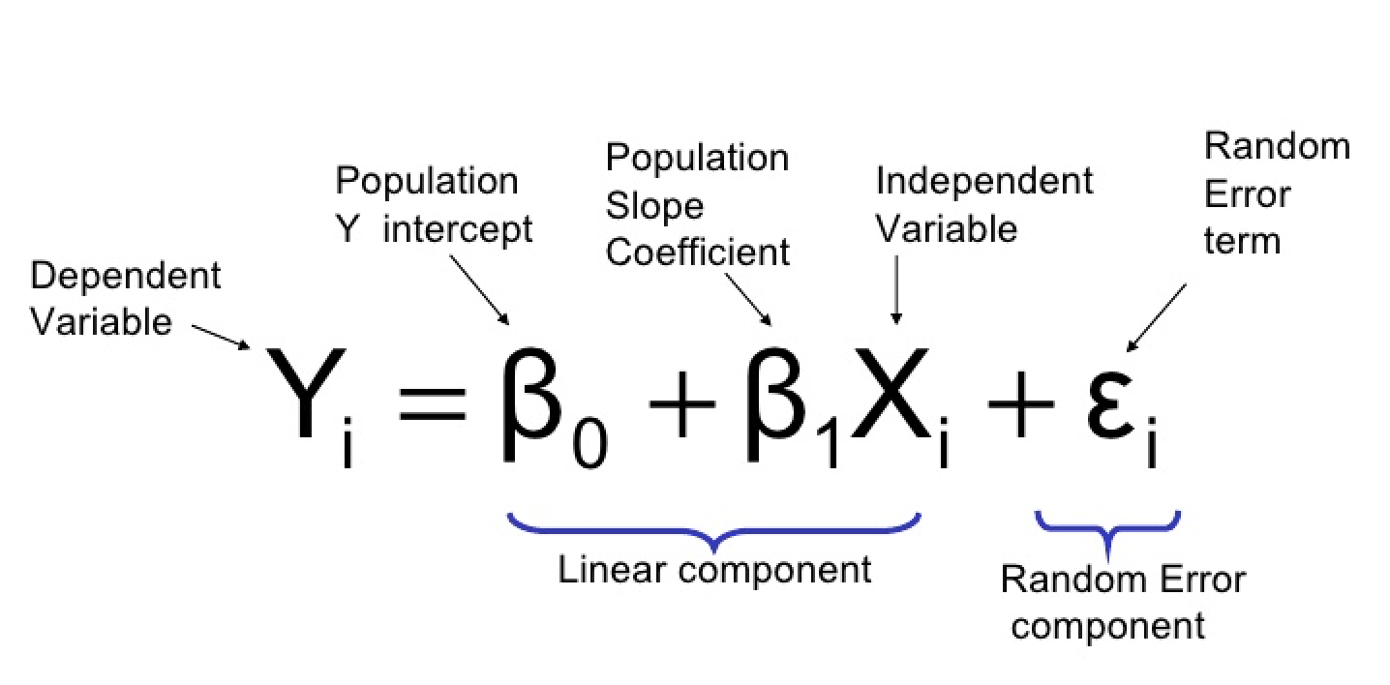
REASONING STATEMENT
No matter how intricately all the different phases in the life cycle have been worked on, if one single step is not carried out or rushed through, it could spoil the entire effort.
The abalone dataset was predicted for age from a Regression Model as it is of business value to consider the granularity of age in pricing the Abalone.
In the ETL pipeline, various plots such as box plots, histograms, correlation matrix to study features, their relationship, and their balance in the data visualize the Data.

Slide 38
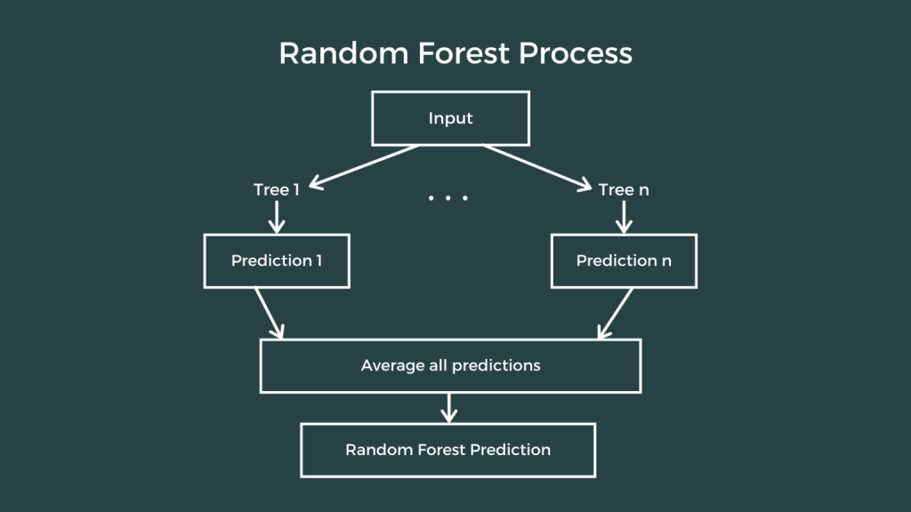
REASONING STATEMENT
Some methods to transform features and handle data imbalance are noted, though not explored. It is critical to understand the data’s limitations (e.g., imbalance) in choosing the right metric to check model performance.
Then we moved on to selecting the features, feature selection helps in figuring out the features that would give good accuracy, we used Pearson’s correlation. Then we trained the dataset using Random Forest Regression after testing out many different algorithms. After which we evaluated the model using Mean Square error.
After which we do a model validation and a model deployment.

Slide 39

KNOWLEDGE
Primary Effects
Secondary Effects
Tertiary Effects

Slide 40
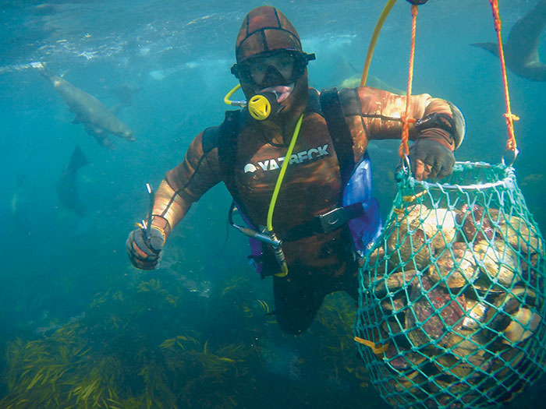
PRIMARY EFFECTS
The intended value of your AI to your business and users.
Accelerates the manual process of determining age of abalone
Increased earnings for farmers & enterprises
Fraud prevention

Slide 41
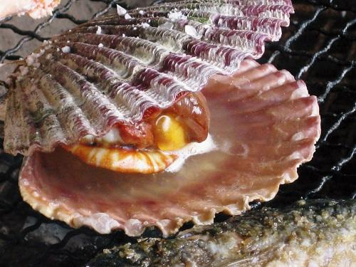
SECONDARY EFFECTS
Any unintended benefits that your AI gives to your business or user.
People who are not interested in abalone, becomes aware and interested
Fact checking to filter out incorrect information about the abalones
Promotes competition in rates

Slide 42
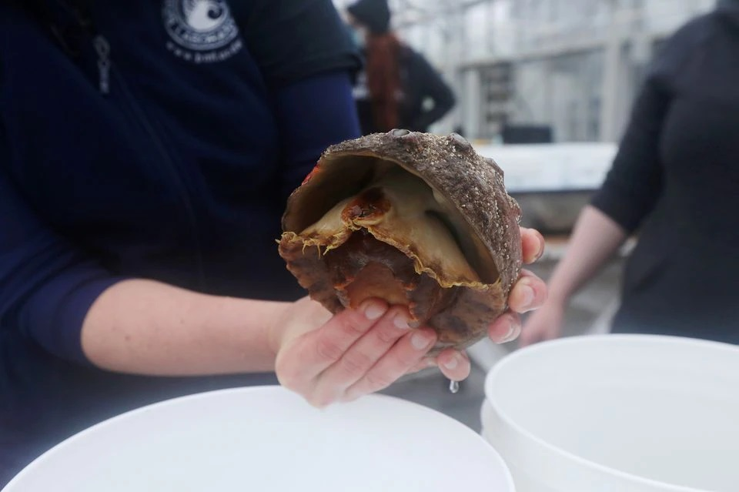
TERTIARY EFFECTS
The unintended consequences of your AI that could negatively impact your business or users.
AI bias, trainings sets might not be ideal
Disrupting natural habitat and food chain
Endangering the species

Slide 43

MVP DEMO
Live online demo
IBM Watson Assistant
Dialog Creation in Watson Assistant
Flow Conversation Design in Watson Assistant
Integration & Technical Architecture

Slide 44

https://predictingabaloneage.herokuapp.com/

Slide 45
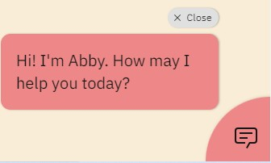
Let’s find out the AGE of your Abalone.
Enter Length
Enter Diameter
Enter Height
Predict Abalone’s Age
The predicted abalone age is 10.35 years

Slide 46

WHY WATSON ASSISTANT?
Most chatbots try to mimic human interactions, which can frustrate users when a misunderstanding arises.
Watson Assistant is more. It knows when to search for an answer from a knowledge base, when to ask for clarity, and when to direct you to a human for questions it can’t answer.
Watson Assistant can run on any cloud allowing businesses to bring AI to their data and apps wherever they are.

Slide 47
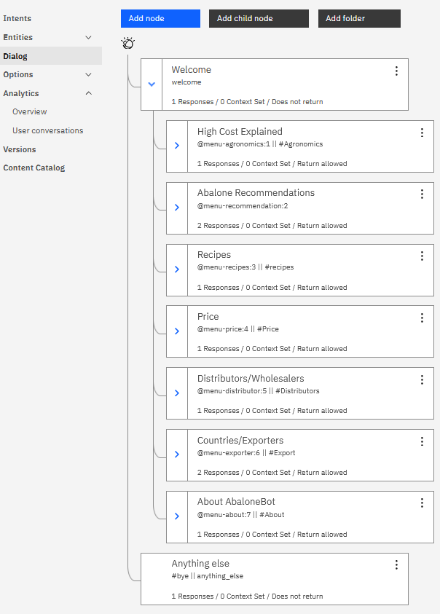


DIALOG CREATION IN WATSON ASSISTANT
What kind of questions can I answer to help?
Scope
Gather requirements for the conversation and how the customer is supporting the use case today.
Defined Persona
Build Empathy Map
Define potential intents and source utterances.
I’m curious about learning more about abalones but I’m not sure what is important and where to start.

Slide 48
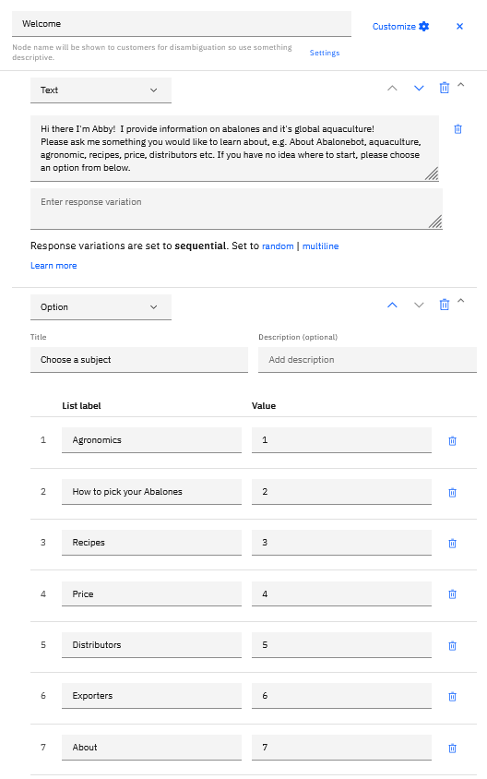
FLOW CONVERSATION DESIGN IN WATSON ASSISTANT
Design
Define Intents
Define Entities.

Slide 49
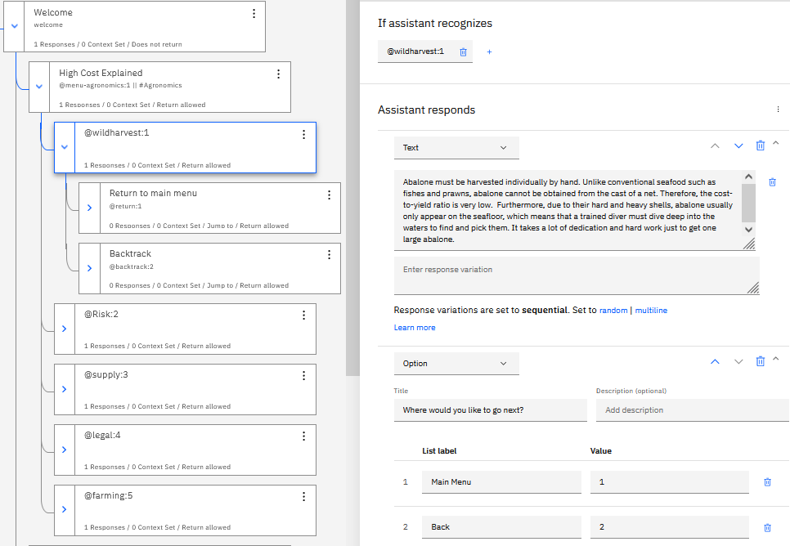
FLOW CONVERSATION DESIGN IN WATSON ASSISTANT
Design
Start dialogue flow and test it.
Playback the conversation to the end user.

Slide 50
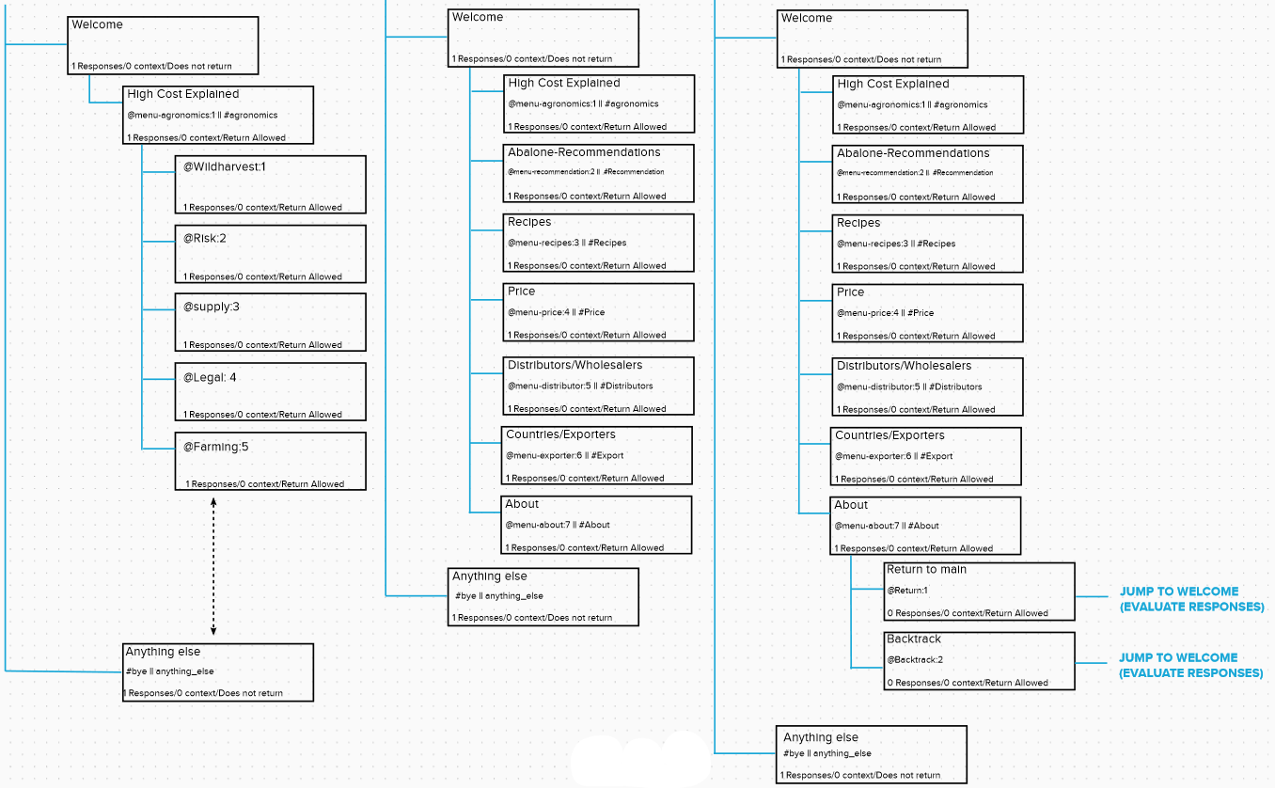
FLOW CONVERSATION DESIGN IN WATSON ASSISTANT

Slide 51
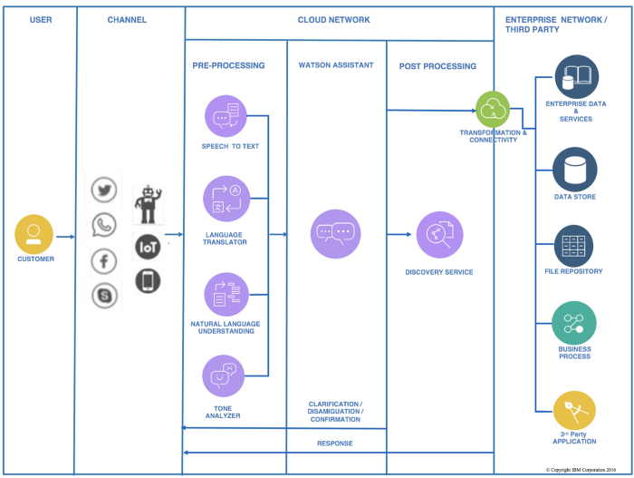
INTEGRATION &TECHNICAL ARCHITECTURE

Slide 52
PROJECT LEARNINGS
Constraints and Challenges
Integration and Development

Slide 53
CONSTRAINTS & CHALLENGES
Name | Remarks
Anisah Binte Sudarman | Tried to attain a model at IBM which was what was usually introduced to us but the CUH hours has such ridiculous limitations. Hardly any AI machine learning could be done. Need to have some form of understanding for coding lest, all words, symbols looks weird and alien. Lack of time to learn and practice the tools provided especially with other outstanding tasks. Error messages similar to the flow of understanding among team members and/or lecturer.
Branden Chan | Important to have the right data available before creating a prediction function for machine learning Data for prediction is not very widely available on the internet and still pretty raw Instead of Solution first, we had to find the right data first before the solution Data has to be adjusted and cleansed to customize to do certain predictions; those a lot of trouble shooting has to be done to keep improving the machine learning.

Slide 54
CONSTRAINTS & CHALLENGES
Name | Remarks
Jamie Bin | Finding the ideal data set to work with and data cleansing Felt that there was a lot more we could do with AutoAI and Watson assistant but limited by CUH and lack of knowledge on advanced W.A features. Lack of coding knowledge and by extension difficulty using Jupiter notebook
Jeremy Lim | Originally intended to churn out a movie recommendation AI but encountered a lot of errors as a movie can fall into various movie genres which is unlike the usual AI where it predicts if this person has cancer , i.e. Yes or No. Realized that you need to know how to troubleshoot as during integration, you may get errors.
Norman Tay | Through this project I learned that AI allows machines to learn from previous experiences, through dataset and results in easing manual human-like tasks. Through pattern recognition and correlation of variables, models can be trained with large amount of data and perform with high accuracy. I see it as the technology of the future and revolutionary, with it being able to utilize the data effectively and allow the algorithm to acquire skills and perform tasks efficiently.

Slide 55
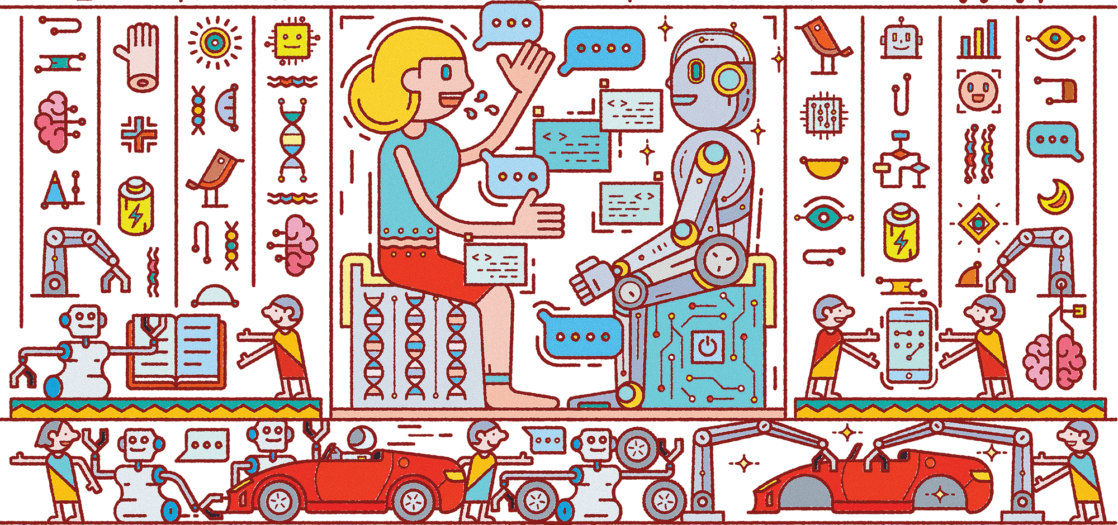
INTEGRATION & DEVELOPMENT
AI tools mostly comply with 3 basic principles:
Learning: Acquiring and processing the new experience, creating new behavior models.
Self-correction: Refining the algorithms to ensure the most accurate results.
Reasoning: Picking up the specific algorithms to resolve a specific task.

Slide 56
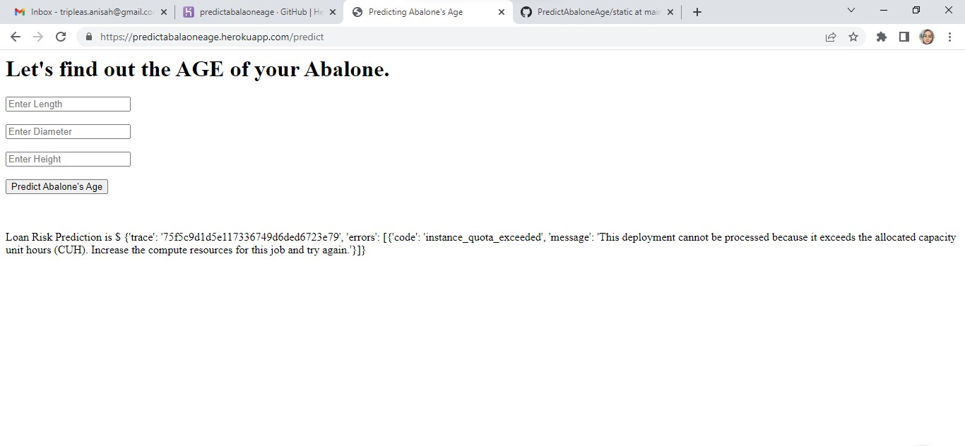
INTEGRATION & DEVELOPMENT
Limited CUH hours has rendered the deployment pointless.
Basic Html coding is necessary to understand the outlook of the deployed website.

Slide 57
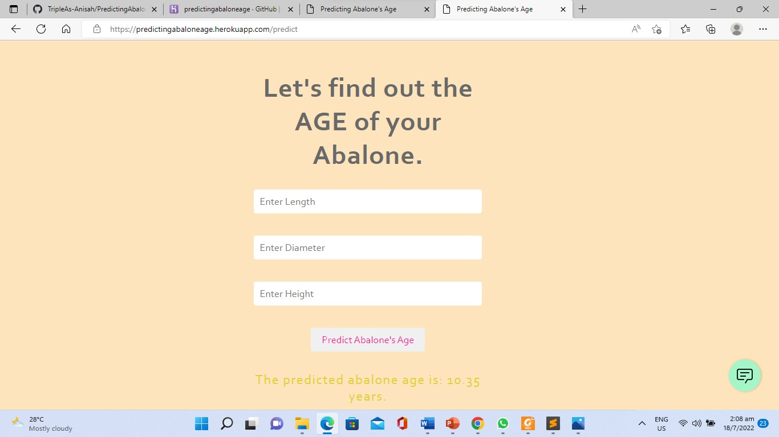
INTEGRATION & DEVELOPMENT
Using sources with unlimited machine learning is ideal for deployment of model into website
Basic understanding of hex codes is necessary to ensure words can be seen.

Slide 58
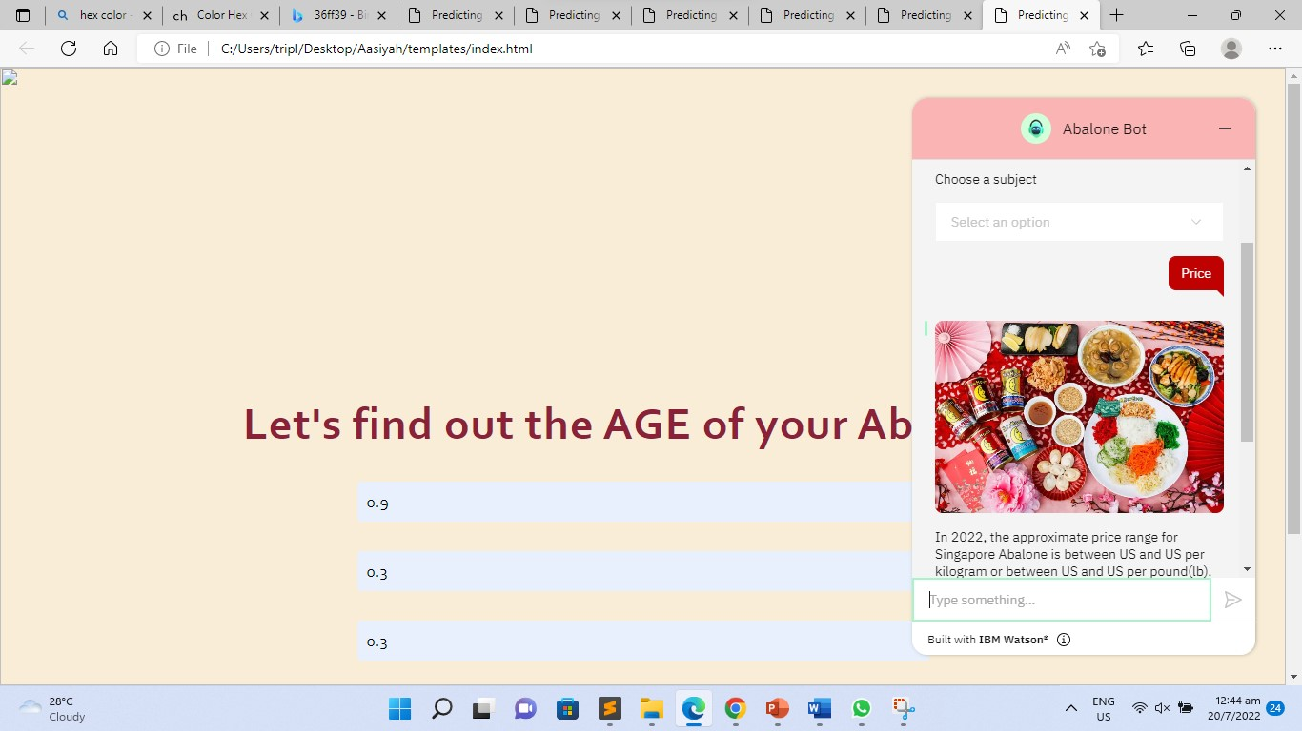
INTEGRATION & DEVELOPMENT
Continuous trial and error is needed within a deployment session to achieve the desired expectations
Understanding basic Html coding is necessary to allow the website to function as expected.

Slide 59

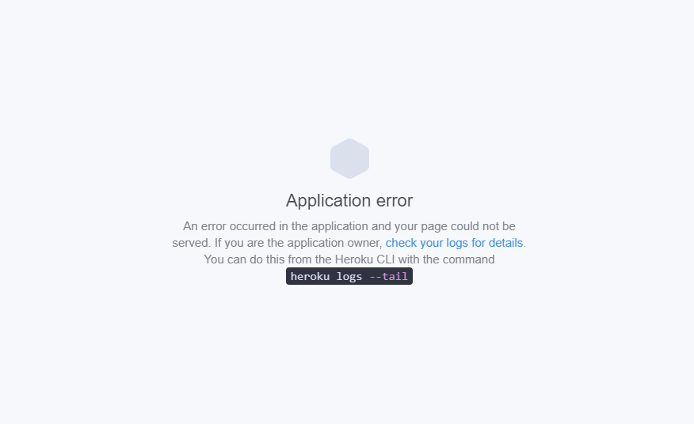
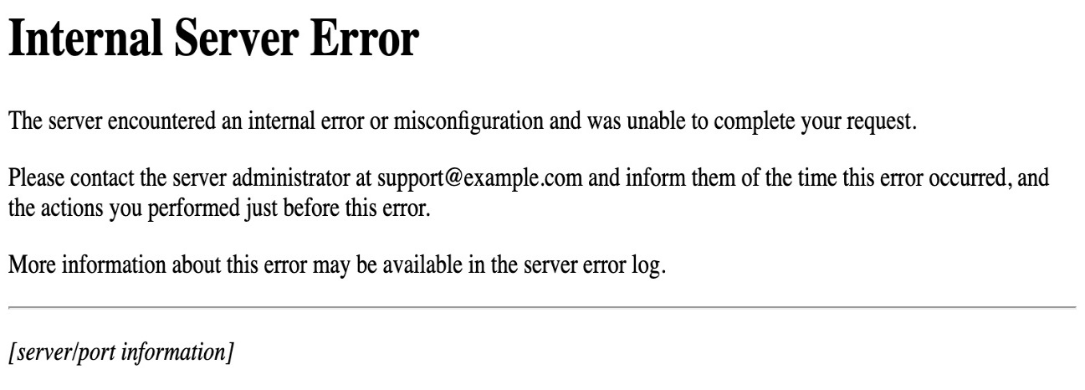


Slide 60
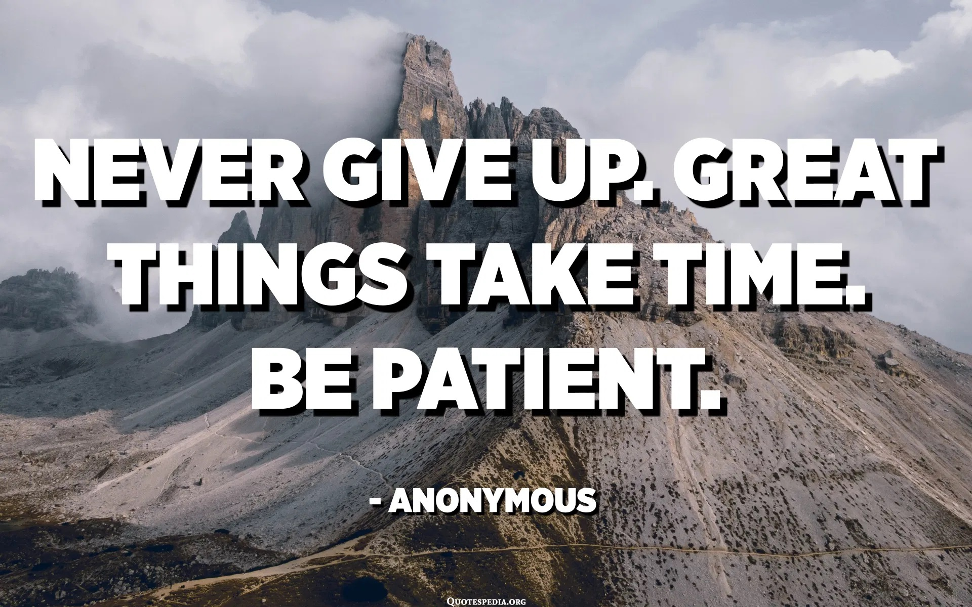

Slide 61


Slide 62
REFERENCES
QR Code Generator - Free Custom QR Code Maker and Creator with logo (qrcode-tiger.com)
https://www.w3schools.com/html/tryit.asp?filename=tryhtml_paragraphs
https://www.img2go.com/resize-image
Color Hex Color Codes (color-hex.com)
https://github.com/watson-developer-cloud/assistant-skill-analysis/tree/6a4c729416cf8065e51ad8b0b62aa7747dc7675e/assistant_dialog_skill_analysis/confidence_analysis
https://www.sublimetext.com/
Abalone – Wikipedia
abalone extinct - Search (bing.com)
https://medium.com/ibm-watson/turn-your-faq-pages-into-conversational-ai-8ac7ae7ec793
https://www.freecodecamp.org/news/css-example-css3/
Abalone Dataset | Kaggle
UCI Machine Learning Repository: Abalone Data Set
https://kyusyutabitabi.com/topiccontent/4149

